Slide 1
Region One ESC Adult Education Program
Region One ESC Bilingual Directors Meeting
Catalina Requenez, M.Ed.
Adult Education Supervisor
Instructional Lead
Location: McAllen ISD Staff Development Center
March 12, 2020

Slide 2
Title III, Part A Connection Increasing & Strengthening Family and Community Engagement

Slide 3
Title III, Part A Connection Increasing & Strengthening Family and Community Engagement
https://projects.esc20.net/page/titleIII.purpose
Community Participation Programs
Visit Local Agencies
Adult English as a Second Language (ESL) classrooms and service providers
Local agencies offering free advising services to help students apply to college, find financial aid, etc.
Food banks and other family service agencies
Online resources for learning English
Texas Workforce Commission: career and employability skills

Slide 4
Changing Lives…
Building Better Futures
We offer classes for individuals 18 years of age or older who want to earn their High School Equivalency Certificate (HSE/GED) or learn English.
Goals
Post-secondary Education
Workforce Entry
Technical Training
Quality of Life for Families

Slide 5
Family Literacy Academy
ESL Students
1
Presentations by Partners with Region One ESC
2
Syllabus with Curriculum and Employability Skills Correlations
3
Certificate Based Sessions
4

Slide 6
Career Pathways Academies
1. ESL
Microsoft Office Specialist
Entrepreneurship Cohort
ESL for Professionals (Internationally Trained Students)
2. HSE
Phlebotomy
Hospitality
STC On –Ramp
Medical Office Specialist

Slide 7
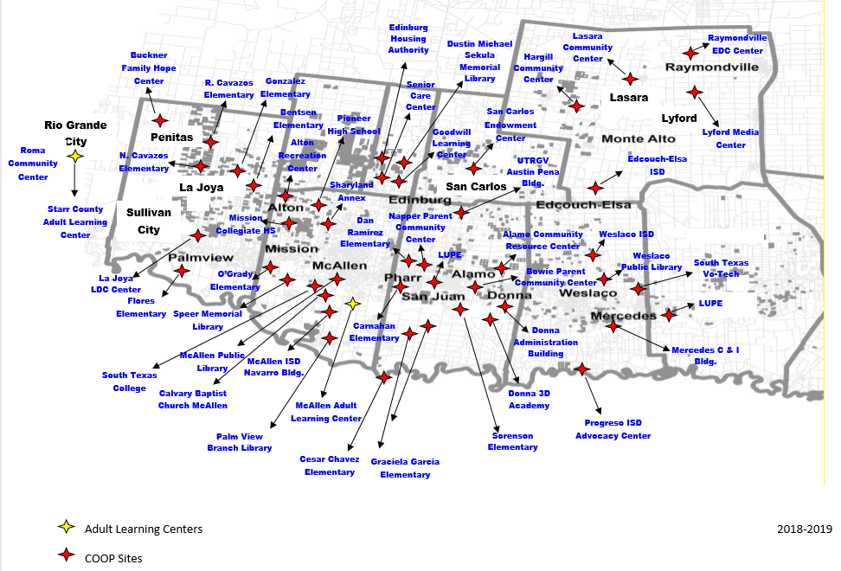
Adult Education Centers and Sites
McAllen Adult Learning Center
Starr County Adult Learning Center- Rio Grande City
Cooperative Sites

Slide 8
Contact Information
Districts Served | Contact Person | Phone number E-mail
Edcouch-Elsa, Lyford, Progreso, Weslaco, La Sara, Mercedes, Donna | Katherine Buentello, Supervisor | (956) 984-6272 kbuentello@esc1.net
Pharr/San Juan/Alamo ISD | Dora Espericueta, Supervisor | (956) 984-6270 despericueta@esc1.net
McAllen, Edinburg | Catalina Requenez, Supervisor | (956) 984-6274 carequenez@esc1.net
Sharyland, Mission, La Joya, Rio Grande City, Roma | Leticia Sanchez, Supervisor | (956) 984-6277 lesanchez@esc1.net
Transition Facilitator | Alfredo Trevino | (956) 984-6033 alftrevino@esc1.net
Adult Education Administrator | Maria Cris Gonzalez | (956) 984-6270 mariacgonzalez@esc1.net

Slide 9
For more information on Adult Education and Literacy:
Please contact the
Region One ESC Adult Education Program
(956) 984-6270
http://www.esc1.net/adulteducation

